Slide 1
ENGLISH MEETING WITH HISTORY & TRADITION
MOBILNOŚĆ KADRY EDUKACJI SZKOLNEJ
INTERNATIONAL HIGH FIVE FOR TEACHERS – TOGETHER FOR INNOVATION
MATEUSZ BŁAŻKÓW
ARTUR PRZYSTARZ

Slide 2
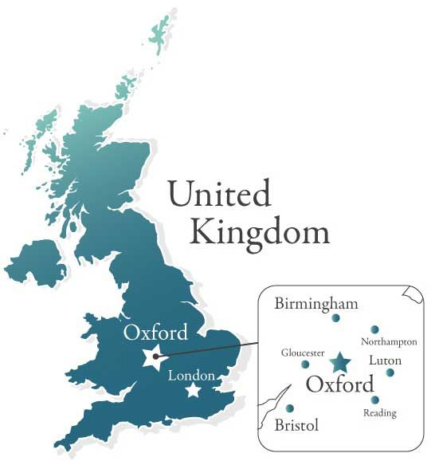
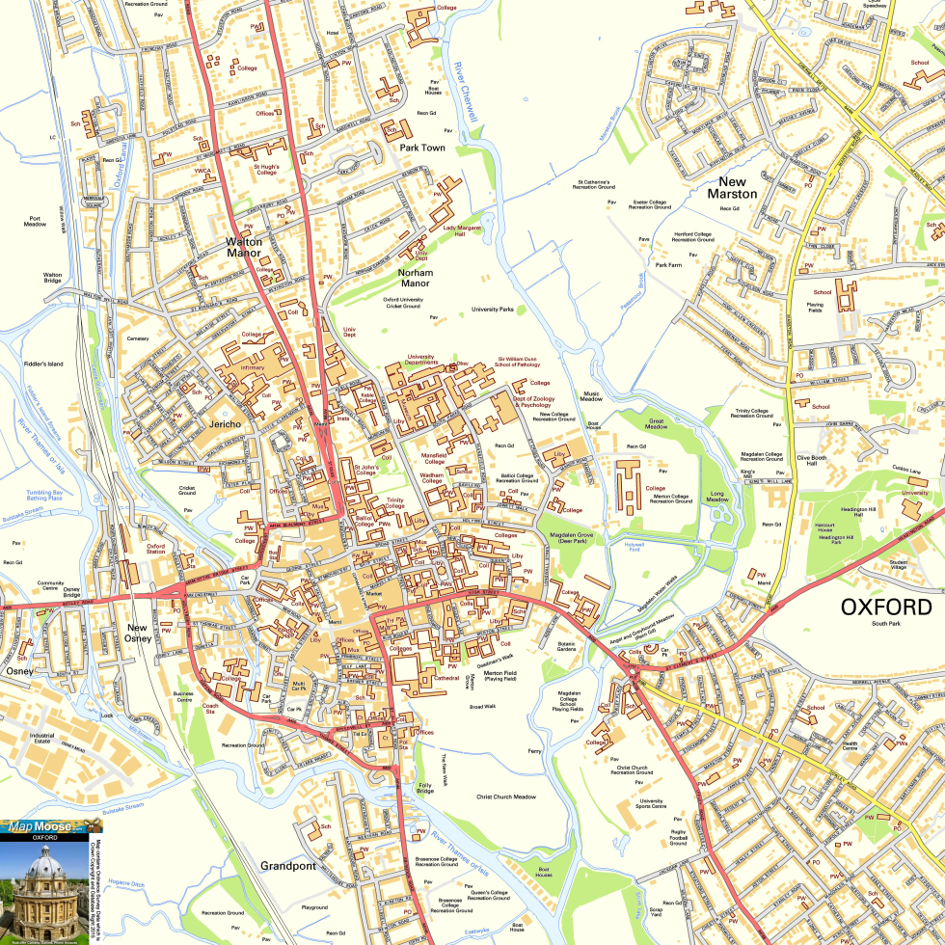
TRIP TO ENGLAND & OXFORD

Slide 3
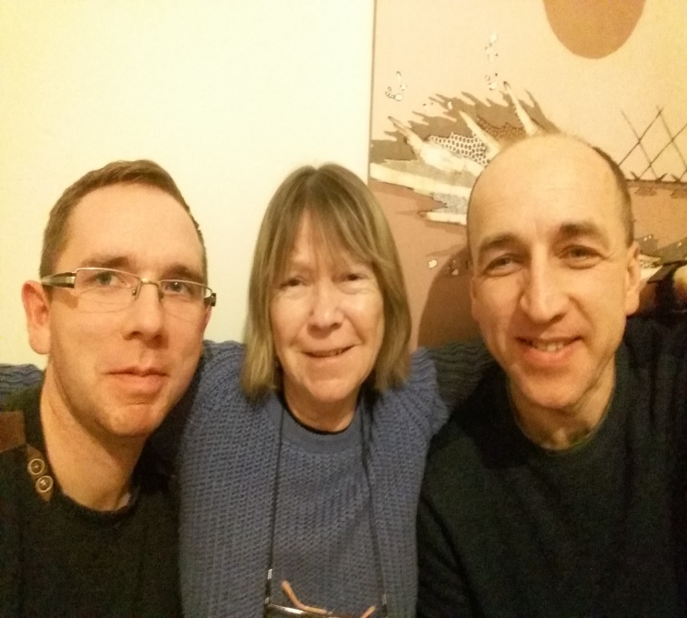
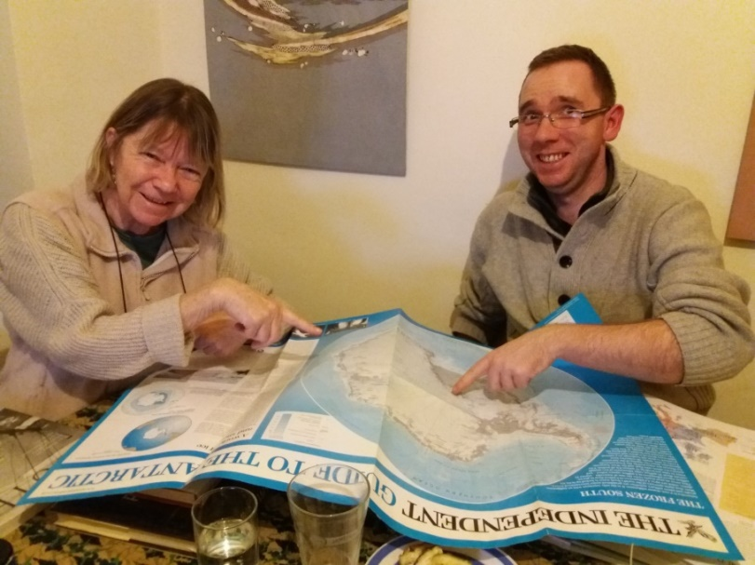
ACCOMODATION
A small English cottage in Oxford's former working class
Polish teachers & Helen - homeowner, retired English teacher

Slide 4
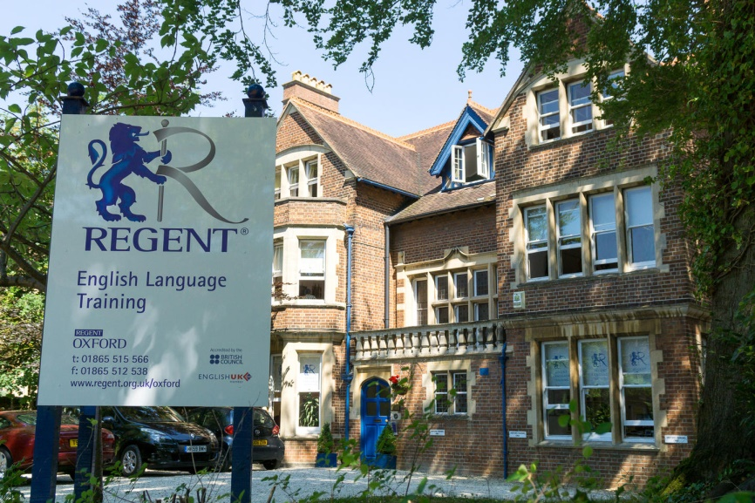
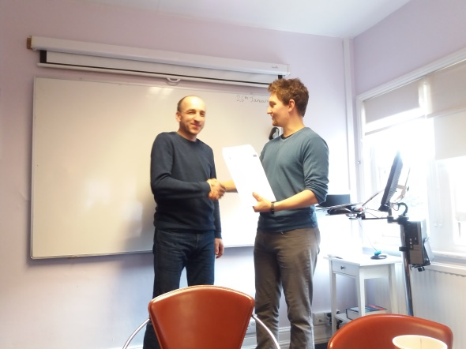
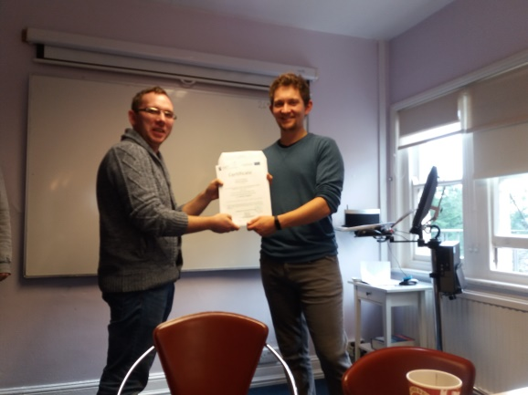
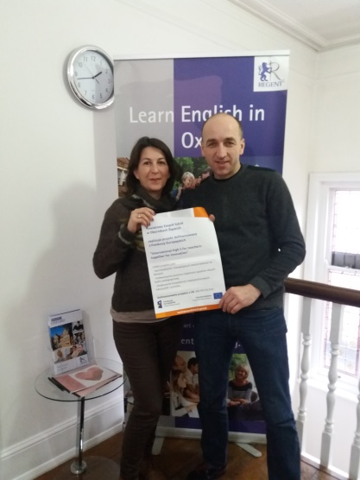
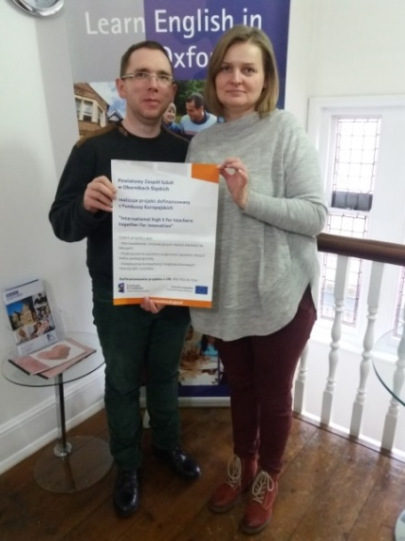
NEW EXPIERENCE - REGENT OXFORD
Regent language school building
Handing out certificates for the completion of a language course
Our international class group.
Polish-Bulgarian team at school

Slide 5
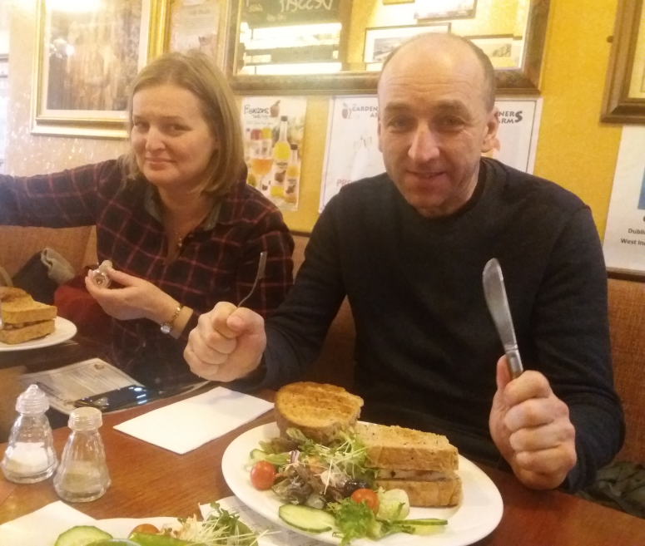
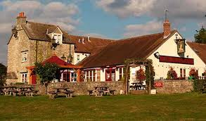
OXFORD’S LUNCH
Teachers always learn English..., even when waiting for lunch

Slide 6
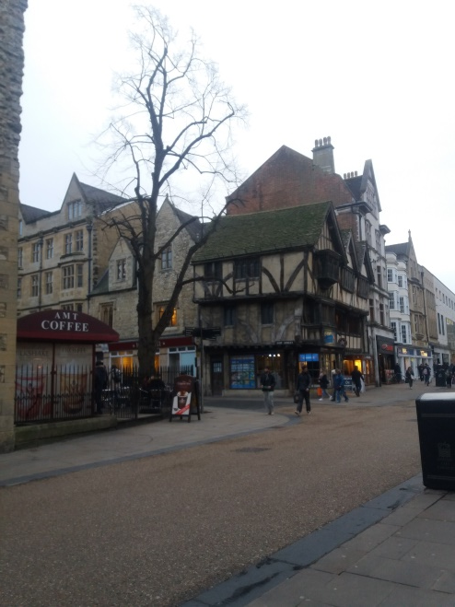
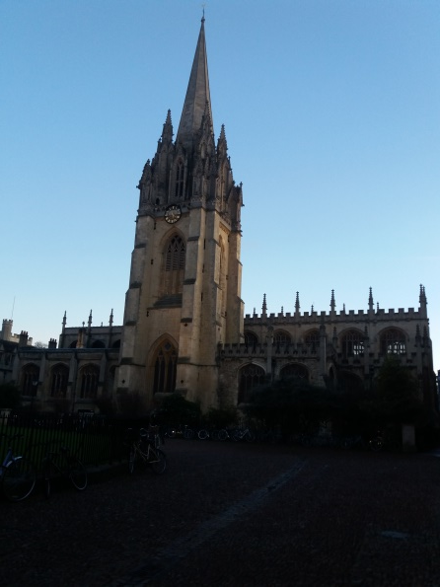
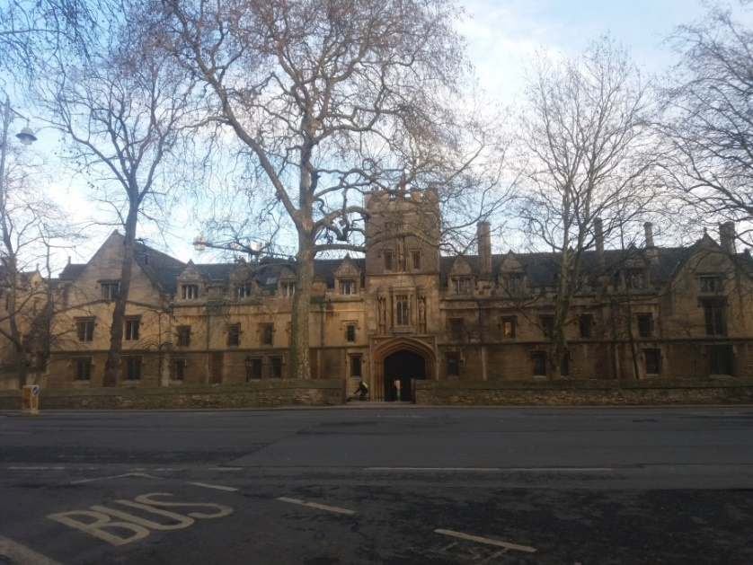
OXFORD – historical and univeristy city
Oxford castle
Old town of Oxford
One of the many colleges of Oxford University

Slide 7
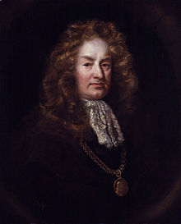
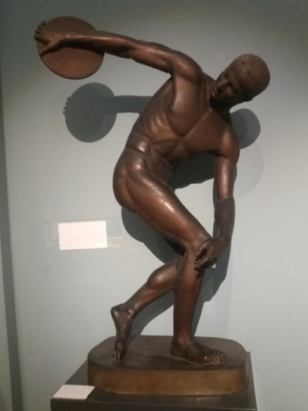
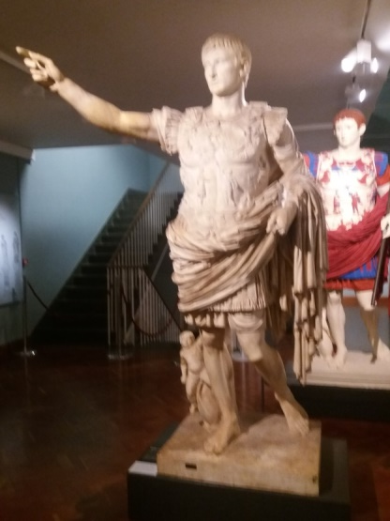
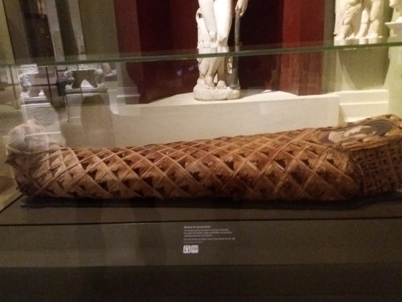
ASHMOLEAN - the largest Oxford museum of ancient collections
Elias Ashmole - creator of the basics of the museum's collection
Main entrance to Ashmolean
Ancient objects in the museum: Greek, Roman and Egyptian art

Slide 8
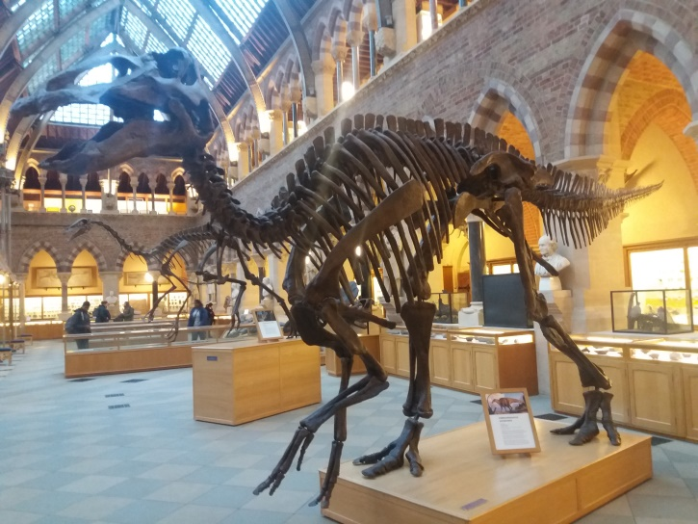
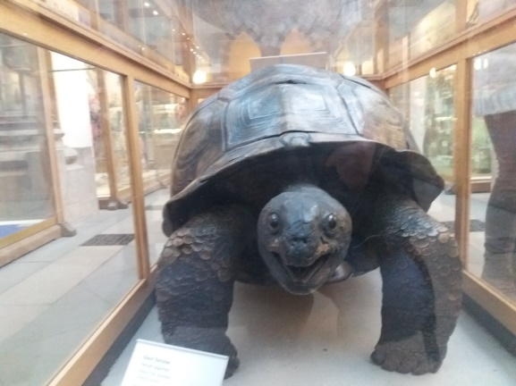
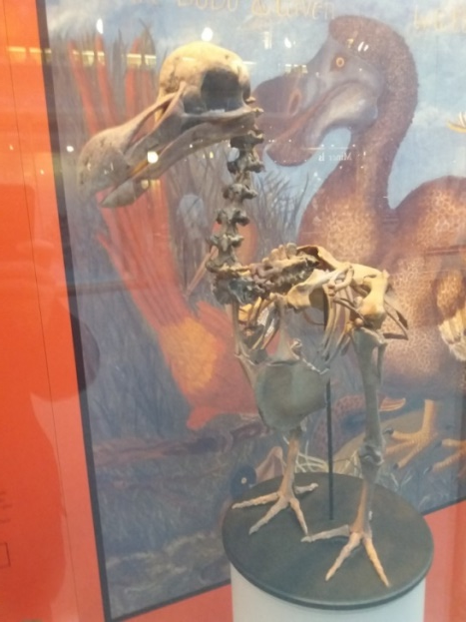
OXFORD UNIVERSITY MUSEUM OF NATURAL HISTORY
The main building of the museum

Slide 9
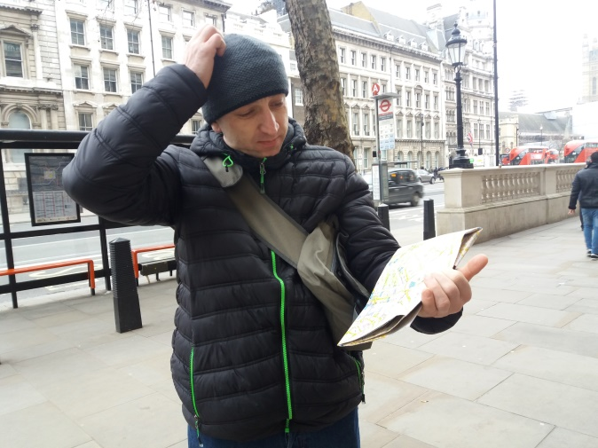
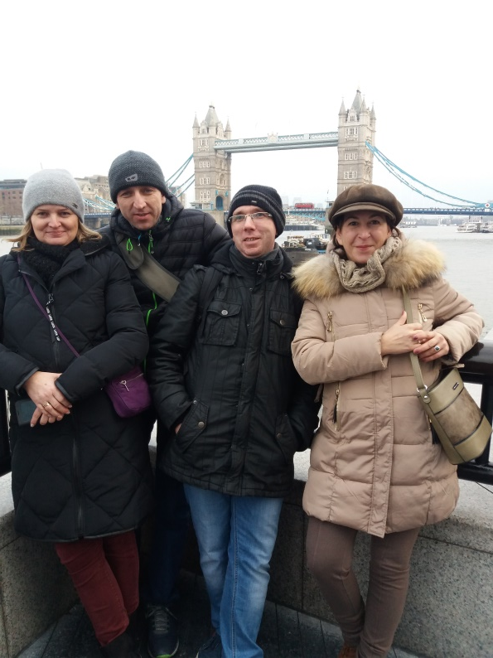
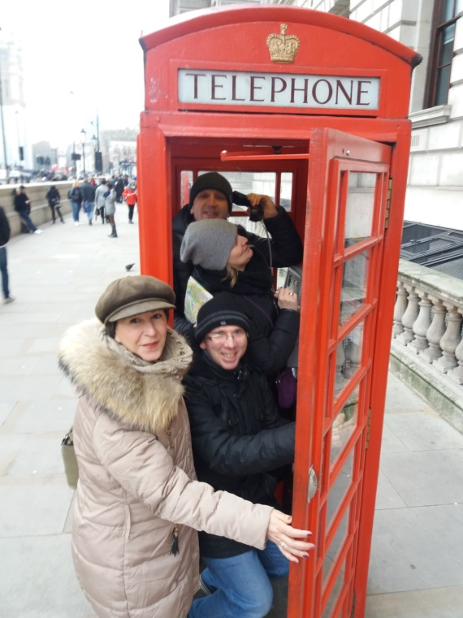
LONDON TRIP
Teachers, sandwiches & London

Slide 10
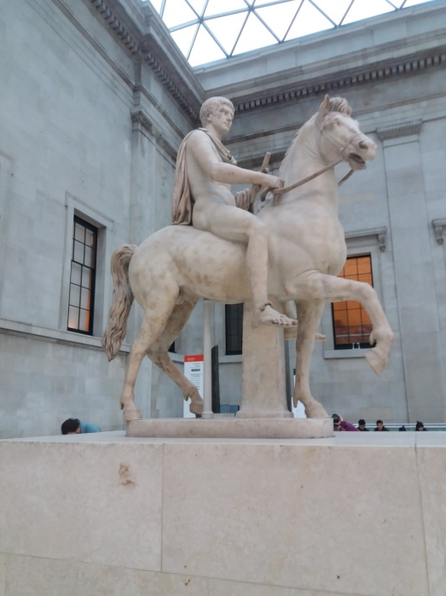
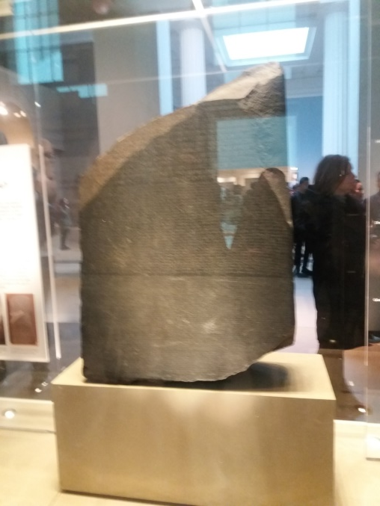
BRITISH MUSEUM
British Museum - museum where everyone will find something for themselves

Slide 11
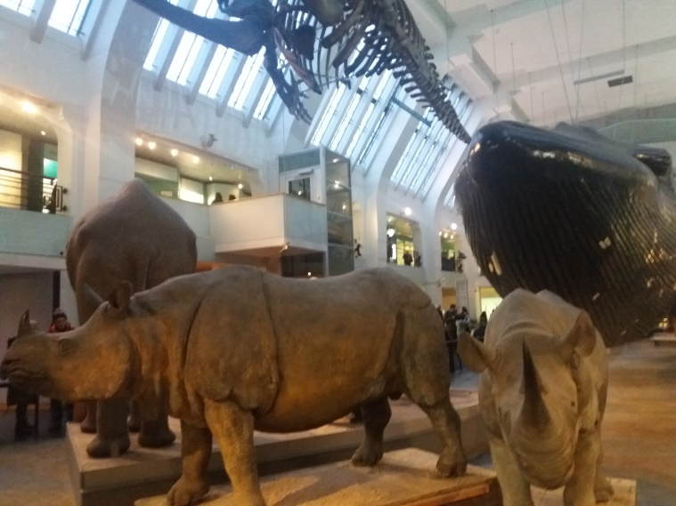
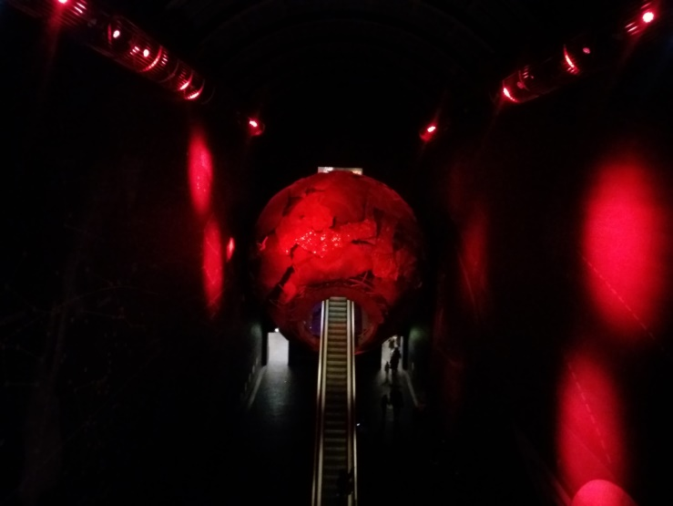
LONDON MUSEUM OF NATURAL HISTORY
An unusual place for every geographer, archeologist and biologist.

Slide 12
WE INVITE YOU TO ENGLAND & OXFORD!!!

